Slide 1
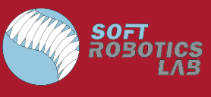
CLARA: Continuum Locomotive Alternative for Robotic Adaptive-exploration
Presented by:
Brian Katz (RBE/ME)
Kate Wheeler (RBE/ME)
Advised by:
Prof. Çağdaş Önal

Slide 2
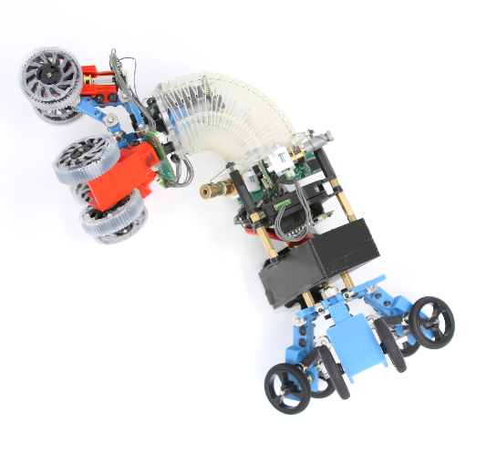
Presentation Outline
Background & Motivation
Project Objectives
Mechanical System Design
Control System Design
Electrical Architecture
Results and Conclusion
Acknowledgements
Notes:
kate
what we’ll be talking about
why we did this project
what we set out to do
what we actually did
and the results and contributions

Slide 3

Project Motivation
& Background

Slide 4
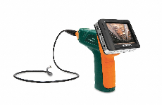
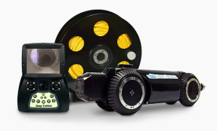
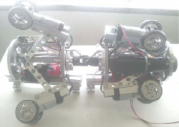
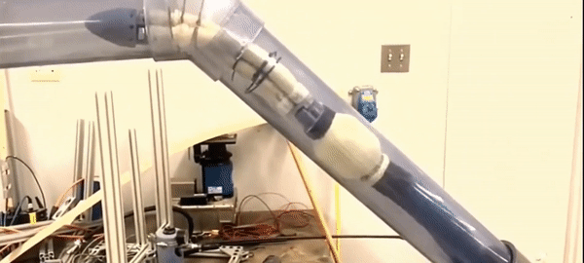
Project Motivations
Pipe systems are prone to fouling, cracks, and leaks
Challenging for humans to explore entire pipe networks that span large areas
Current forms of remote pipe inspection are limited in their maneuverability
Borescopes
Crawlers
Worms
Expensive and cannot be applied to smaller diameters
Tethering limits exploration
Grainger Video Boroscope, Deep Trekker DT340, Pukyong Pipe Inspection Robot, GE Pipe-worm [1][2][3][4]
Notes:
kate
Complex pipe networks are the backbone of many industries, ranging from aerospace to HVAC, and are even found in households everywhere
but are prone to fouling, cracks,and leaks, which can all cause extreme physical and monetary damage when unchecked
as such, they should be inspected and monitored frequently to check for these types of damage
there are some current methods to inspect pipe systems, most traditionally with borescopes, which are maneuverable tubes with a camera on the end, hard to use
in recent years some robotic solutions have been developed, but these tend to be expensive systems that often face disadvantages including
being tethered, only viable for a single size of pipe, and unable to traverse vertical pipes,
which really highlights the need for a robot that meets all of these qualifications

Slide 5
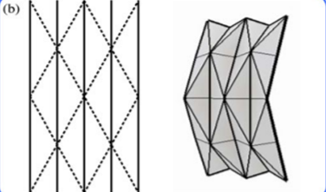
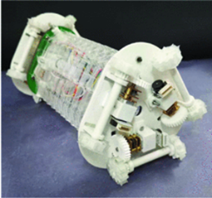
Background
Origami is a tool to create desired mechanical behavior when rigid mechanisms are insufficient
Patterns produce varied behavior
Yoshimura pattern - axial compression
Salamanderbot
Applied Yoshimura pattern with thread and motors to compress the module, climbing sharp inclines and navigating through turns
Notes:
Brian
Origami can be used as a design tool to create unique mechanical behaviors which typically require complex rigid mechanisms to achieve
There are many origami patterns, such as the waterbomb base, herringbone, and the Yoshimura pattern pictured here which produce varied behavior, anywhere from compression to collapsing to rotation which simplify mechanism design
The Salamanderbot, developed by WPI’s Soft Robotics Lab, applied the Yoshimura pattern using laser-cut Polyethylene sheet, threads and motors to compress the module and overcome challenging terrain

Slide 6
Project Objectives

Slide 7
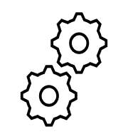
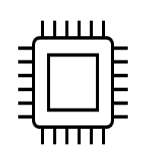

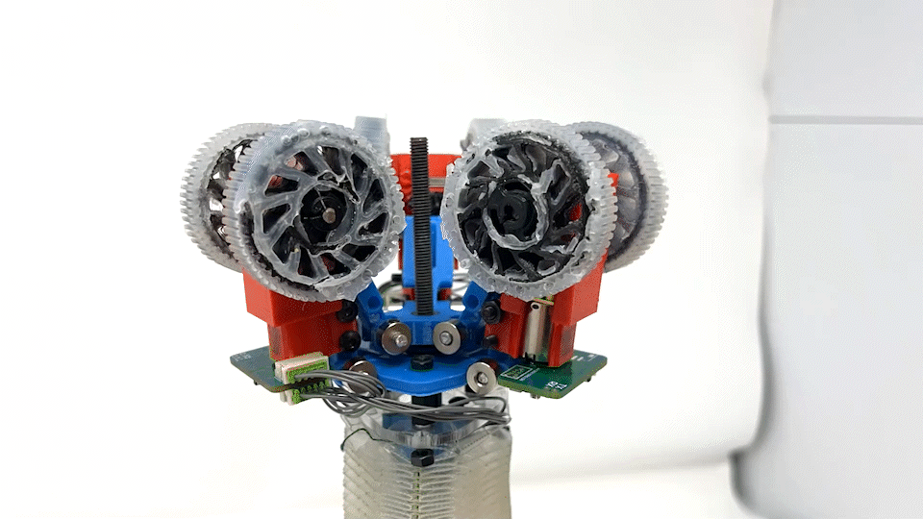
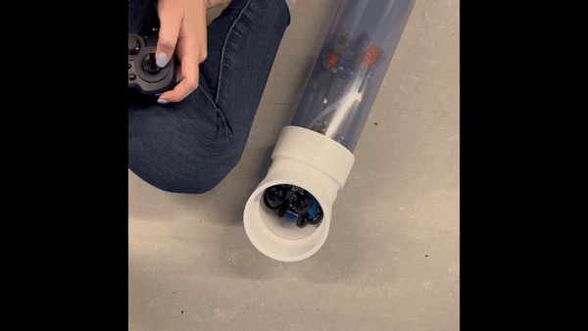
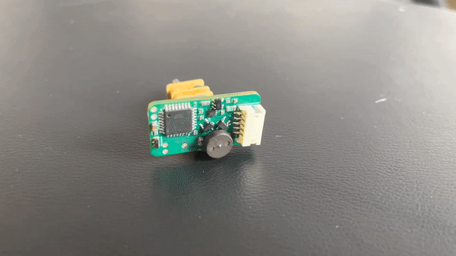
Project Objectives
Goal: Explore the capabilities of a soft robotic origami module in the inspection and exploration of pipe networks too small, expansive, or dangerous for humans.
Notes:
kate
our goal for this project was to adapt the existing Salamanderbot design in order to make it more suitable for pipe inspection and exploration
this involved shrinking the entire robot substantially, as well as making substantial overhauls to the suspension, electrical infrastructure, and overall design
particularly, we had a three pronged approach to our objectives that we’ll be talking about today, in which we,
wanted to design and test multiple passive and active suspension mechanisms
wanted to develop a new electrical schema involving smart motor driver boards for n20 gearmotors
wanted to develop a control architecture that would allow for tetherless control of the module

Slide 8
Mechanical Design
Notes:
brian

Slide 9
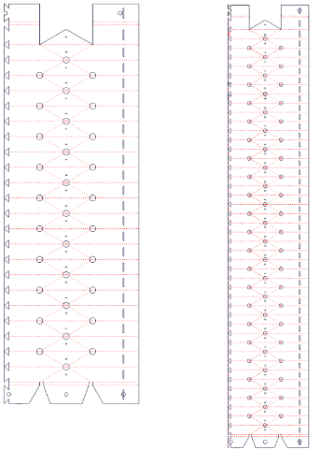
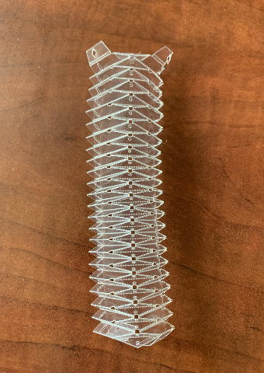
Yoshimura Crease Pattern
Key Benefits:
Controllable linear compression
Increased torsional stiffness
Salamanderbot Yoshimura pattern (left), CLARA Yoshimura pattern(right)
Notes:
Brian
One of our first objectives was to adapt the Salamanderbot to smaller pipe environments. We made the decision to scale the Yoshimura pattern to fit the entire robot within a minimum pipe diameter of 4”.
Here’s a comparison of the Salamanderbot Yoshimura pattern and the CLARA pattern. The updated pattern is longer and thinner to increase linear compression and torsional stiffness in pipe environments to avoid unwanted twisting of the robot

Slide 10
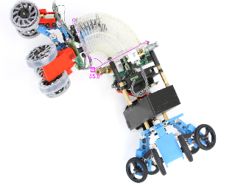
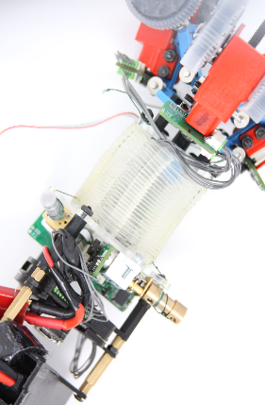
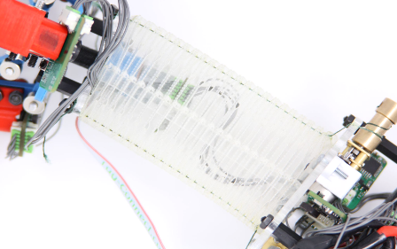
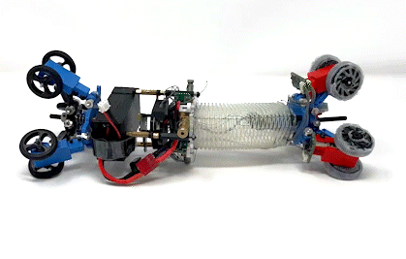
Yoshimura Continuum Module
Maximum Bending
Fully Extended
Fully Compressed
Notes:
Brian
When three Yoshimura crease patterns are connected to one another, they create a triangular module.
It is completely hollow and is composed of PET laser-cut sheets making it light, and allows us to pass cables through the center of our robot, making it more compact
The module can continuously deform as well as axially compress using a set of three mechanical winches connected to cables
With our current configuration, we achieve 4.5” of linear compression and 86 degree maximum bending angle

Slide 11
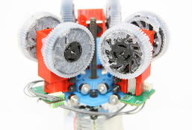
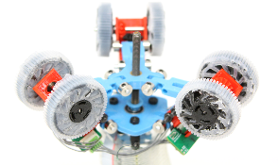
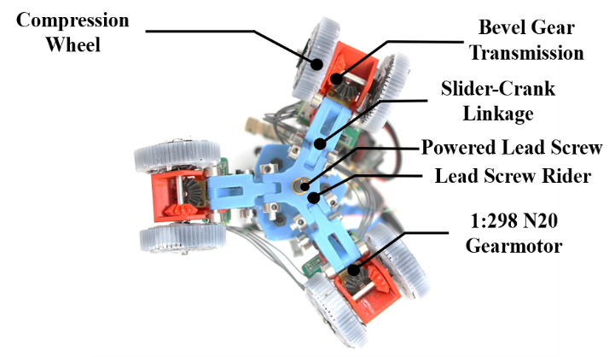
Active Variable-Diameter Suspension
Notes:
brian
This is our drive system mechanism to maneuver through pipe environments.
It has three points of contact to travel vertically, horizontally,and hold its position within pipes
The active transmission is driven by a lead screw, connected to three linkages which meet at a central lead screw rider.
As the lead screw rider rises, the wheels expand radially outward and when it falls they compress inward.
On the other side of the robot, we feature a similar passive mechanism which substitutes the lead screw for a spring to act as a follower to the active side
Each transmission module features two compression wheels, made from flexible material and casted in silicone for additional traction in slippery pipe environments

Slide 12
Electrical and Control Architecture
Notes:
kate

Slide 13
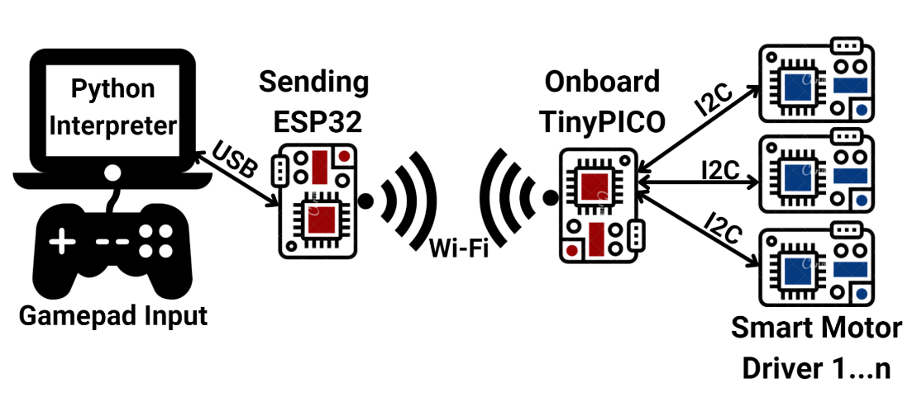
Control Architecture
Notes:
The goal for controlling this robot was to have an untethered system, able to be driven by a game controller
As such, we interpret the input from a gamepad using a python script, which is then written over serial to be interpreted by an ESP32.
The esp then sends these commands to the robot using the ESPNOW wifi protocol, which receives the commands and distributes the commands to the relevant smart motor driver boards over I2C.
This infrastructure is both wireless and scalable, meaning the system could integrate as many motors as one would like, and allows us to receive real-time data from the robot and also provide tele-op commands in a way that is easy to understand and intuitive to use.

Slide 14
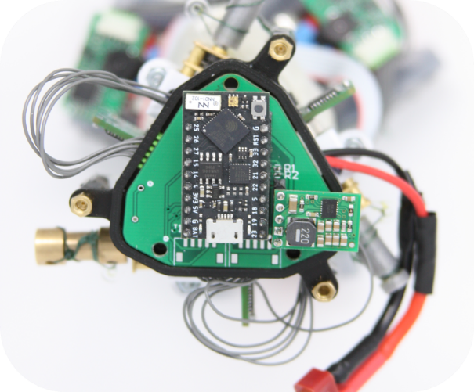
Mainboard PCB Design
TinyPICO (ESP32 microcontroller) enables untethered WiFi communication with ESP-NOW
Onboard power regulation to step down 7.4V motor voltage to 3.3V for logic voltage
Notes:
kate
in order to receive wifi commands and facilitate communication with the smart motor drivers, we developed a mainboard PCB to house the ESP32 tinyPICO as well as provide a buck regulator to step down the battery and motor level voltage to logic level voltage for operation

Slide 15
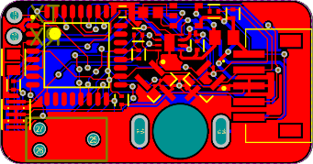
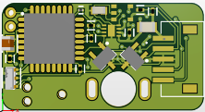
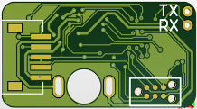
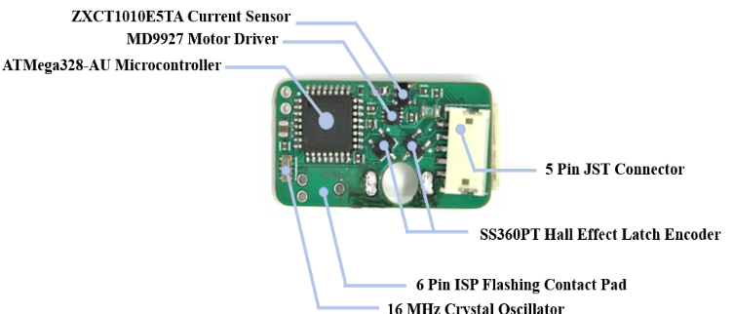
Smart Motor Driver PCB Design
Provides power, sensing and control with encoders, current sensors, motor drivers, and a microcontroller
Daisy-chain compatibility using I2C, providing a scalable system
Notes:
kate
The motivation to design these smart motor driver boards was initially driven by needing to shrink our electronic infrastructure
having a mainboard with these modular motor drivers means that you could scale the system without having to redesign an entirely new pcb
these smart motor drivers are intended for an n20 gearmotor, but could also be used with other small motors
the boards use an ATMEGA328 microcontroller programmed with a 6 pin ISP connector, and communicate via I2c
have a current sensor for load sensing, and quadrature magnetic encoders for position and velocity control/analysis

Slide 16
Results
Notes:
kate

Slide 17
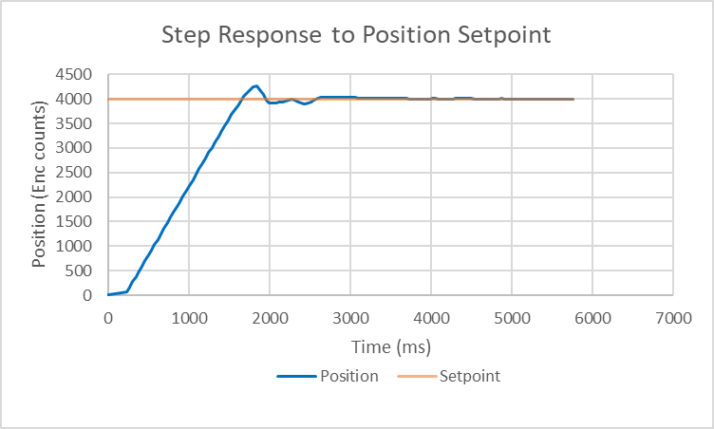
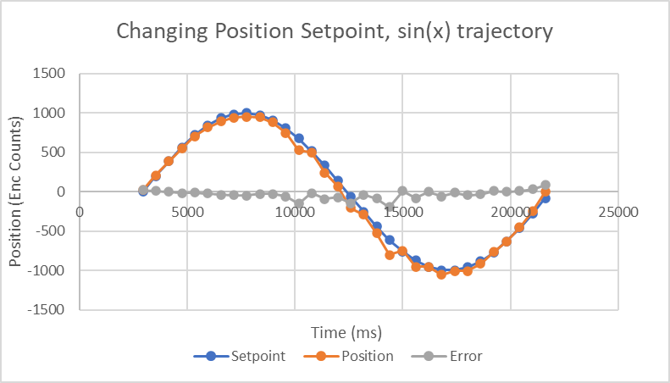
Results: Motor Driver Performance
Motor step response to a position setpoint
Motor response to sinusoidal position tracking
Notes:
kate
we started by trying to quantify the performance of our motor drivers, which we did with a series of tests after tuning PID control
We tested a step response to a positional setpoint as well as response to a changing position trajectory, and found that the motor driver was able to quickly reach setpoints with little oscillation or error

Slide 18
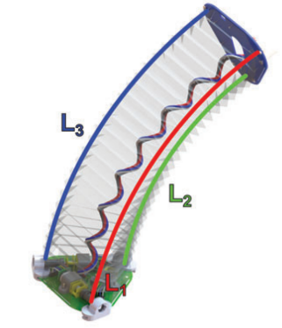
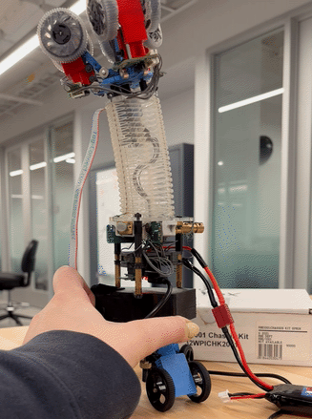
Results: Yoshimura Module Control
Notes:
kate
After creating our yoshimura module, we wanted to validate that our configuration and usage of the module would still follow the kinematic models developed in previous papers
This was important, as having an accurate inverse kinematic model means that we can figure out how to create any shape with the module or send it to any point within its task space, just by altering the cable lengths
we found that this Ik model, combined with the ability of our motors to go to positional setpoints, meant that we were able to have accurate control over the module shape

Slide 19
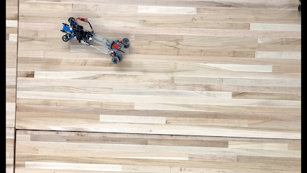
Results: Navigation and Steering
Notes:
brian
Here’s a video of the steering capability of the robot shown in 2x speed
From our controller, we can variably change the bending angle of the Yoshimura module, allowing us to overcome a wide range of turns, upwards of 90 degrees with the mechanical compliance of the PET sheet.
As opposed to a differential drive robot, this robot achieves steering by physically deforming its soft body rather than a difference in wheel speeds
We can even roll the robot over from a 2 wheel configuration to a 1 wheel configuration

Slide 20
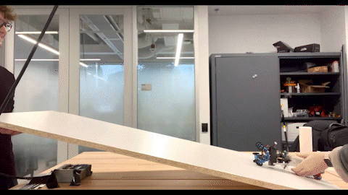
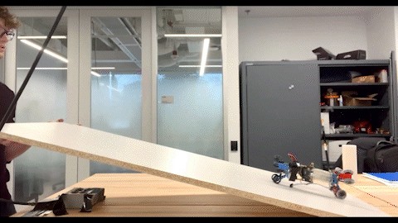
Results: Navigation and Steering
Two-Wheeled Incline Test - 1.5x Speed
One-Wheeled Incline Test - 1.5x Speed
Notes:
brian
Our robot can overcome significant inclines with the traction of the silicone/TPU compression wheels
Here’s a few videos of one of our incline tests on a flat, wooden surface to determine the maximum incline angle that could be traversed by the robot.
We tested both a two-wheel configuration and a one-wheel configuration and found that one set of driven wheels contacting the ground produced the most desirable result when slipping occurred around 60 degrees

Slide 21
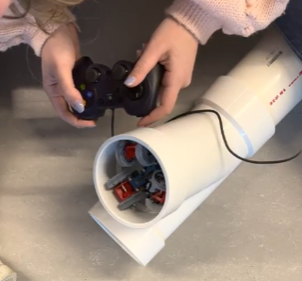
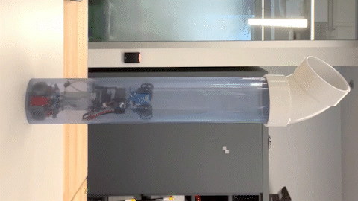
Results: Pipe Navigation
Notes:
brian
Here’s a video of one of our most challenging tests. Our robot is able to traverse a vertical pipe environment, both forward and reverse and hold its position in the pipe
The robot can overcome pipe bends, as you can see the robot emerge from the other end of the bend.
We also performed other tests, such as the robot overcoming a T-junction, where we had to control the module to choose a path as well as change its diameter to pass through intermittent expansions and reductions in pipe diameter.

Slide 22
Fundamental Contributions
Goal: Explore the capabilities of a soft robotic origami module in the inspection and exploration of pipe networks too small, expansive, or dangerous for humans.
Notes:
kate
To recap, we believe the fundamental contributions that this project makes came in three forms
first, we presented a novel active suspension mechanism for overcoming multiple pipe sizes
second, we featured a smart motor driver designed and assembled in house than can be used widely beyond the scope of this project
and last, we have offered a solution to the challenging pipe inspection problem that meets qualifications that current robot solutions are lacking in

Slide 23
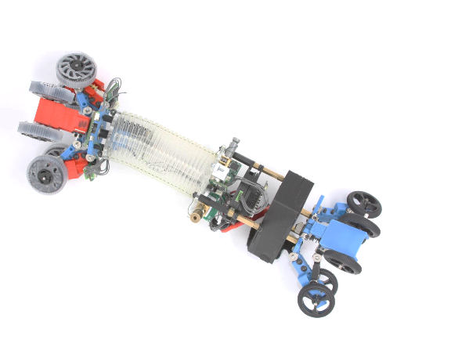
Results and Conclusion
Category | Value | Units
Weight | 1.1 | lbs
Yoshimura Module Length | 1.5-6.0 | in
Maximum Turning Radius | 85.8 | deg
Effective Diameter Range | 3.6-5.2 | in
Wheel Compression | 0.3 | in
Maximum Speed | 6 | in/s
Notes:
kate
we decided to quantify some of the behavior of our robot, which is summarized above
this was done primarily through motion tracking using physlets tracker, which allowed us to measure various behaviors like speed and maximum turning radius
by creating a robot that uses a majority of 3D printed parts, as well as common microcontrollers and PCBs assembled in house, CLARA presents an alternative to the current pipe inspection robots on the market that commonly come at a much higher price tag
overall, we feel that CLARA provides a promising solution to the challenging problem of pipe inspection and navigation, and opens the door to using soft robotics in real-world applications

Slide 24

Dedication & Acknowledgements
Questions?
We dedicate this Major Qualifying Project to Jiyang “Jeffrey” Wu, our third partner, who passed away in the summer of 2021.
Special thanks to our advisor:
Professor Onal
Additional thanks to:
Professor Greg Lewin
Professor Markus Nemitz
Gabby Conard
Dan Moyer
Yinan Sun
Yoni Weiner
The OREO’d MQP team (Tyler Looney, Archie Milligan, Daniel Perno,
Nathan Savard, Michael Scalise, Augustus Teran, Ryley Wheelock)
Notes:
brian

Slide 25
Citations
[1] “Video Borescope, 5.2mm Camera Head,” Grainger. https://www.grainger.com/product/FLIR-Video-Borescope-60PT84
[2] “DT340L Pipe Crawler Package,” Deep Trekker. https://www.deeptrekker.com/shop/products/dt340l-pipe-crawler-package
[3] G. Hunt and I. Ario, “Twist buckling and the foldable cylinder: An exercise in origami,” Int. J. Non-Linear Mech., vol. 40, pp. 833–843, Jul. 2005, doi: 10.1016/j.ijnonlinmec.2004.08.011.
[4] Brian Heater, “GE’s worm robot sports roach-style whiskers to remove fat deposits from sewage pipes,” TechCrunch, Mar. 08, 2022. https://techcrunch.com/2022/03/08/ges-worm-robot-sports-roach-style-whiskers-to-remove-fat-deposits-from-sewage-pipes/
[5] J. Santoso, E. H. Skorina, M. Luo, R. Yan, and C. D. Onal, “Design and analysis of an origami continuum manipulation module with torsional strength,” in 2017 IEEE/RSJ International Conference on Intelligent Robots and Systems (IROS), Sep. 2017, pp. 2098–2104. doi: 10.1109/IROS.2017.8206027.
[6] Y. Sun et al., “Salamanderbot: A soft-rigid composite continuum mobile robot to traverse complex environments,” in 2020 IEEE International Conference on Robotics and Automation (ICRA), May 2020, pp. 2953–2959. doi 10.1109/ICRA40945.2020.9196790.
[7] Santoso, Junius, and Cagdas D. Onal. "An origami continuum robot capable of precise motion through torsionally stiff body and smooth inverse kinematics." Soft Robotics 8, no. 4 (2021): 371-386.

